Slide 1
High-Speed Tracking-by-Detection Without Using Image Information
Erik Bochinski et.al

Slide 2
Motivation

Slide 3
Motivation
In brief:
If the detector has excellent performance(which has been well developed in these years) and the video has high frame rate(closer to ‘continuous function’), the MOT problem becomes easier.
In detail:
One typical challenge for tracking-by-detection systems, especially when applied online, is the limited performance of the underlying detector which may produce false positive and missed detections. An ideal tracker is able to handle these flaws by filling the ”gaps” of missing detections (better with high frame rate video) and ignoring false positives
Problem:
My: The simple IOU method in this paper can’t deal with occlusion, so produces a lot of fragments in practice.

Slide 4
Understand the pipeline

Slide 5
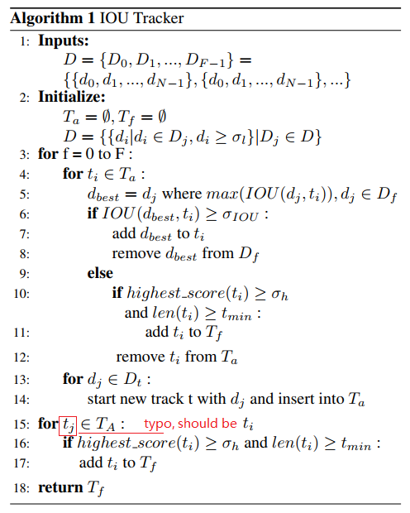
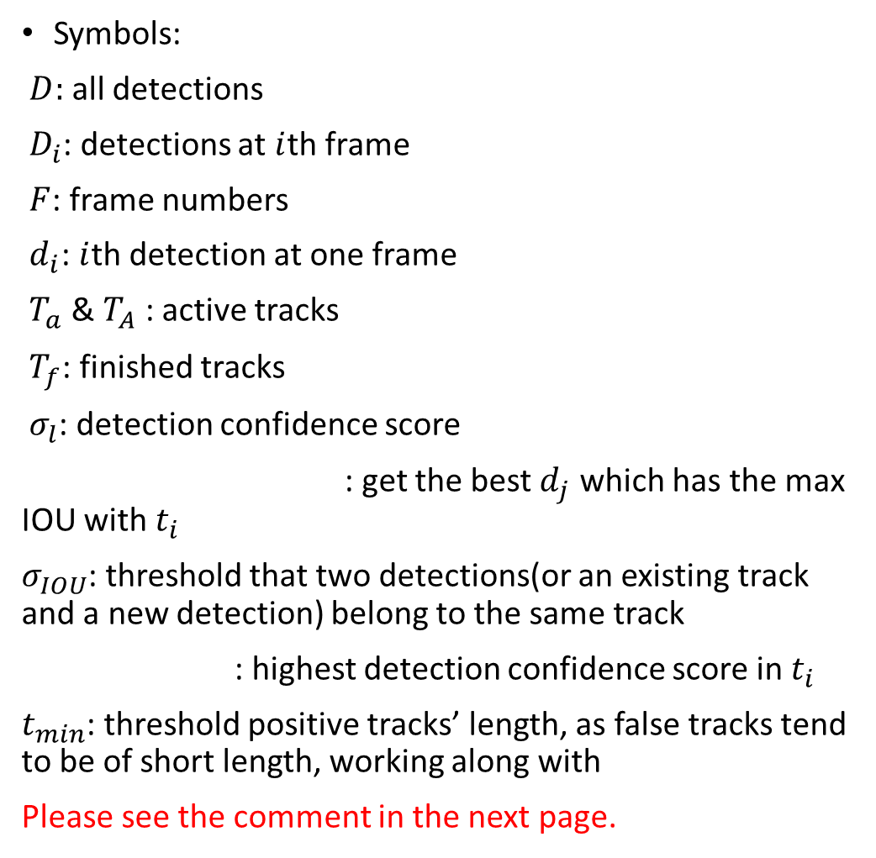
Symbols:
$D:$ all detections
${ D}_{i}$: detections at $i$th frame
$F$: frame numbers
$d_{i}$: $i$th detection at one frame
$T_{a}$ & $T_{A}$ : active tracks
$T_{f}$: finished tracks
$σ_{l}$: detection confidence score
: get the best $d_{j}$ which has the max IOU with $t_{i}$
$σ_{IOU}$: threshold that two detections(or an existing track and a new detection) belong to the same track
: highest detection confidence score in $t_{i}$
$t_{min}$: threshold positive tracks’ length, as false tracks tend to be of short length, working along with
Please see the comment in the next page.

Slide 6
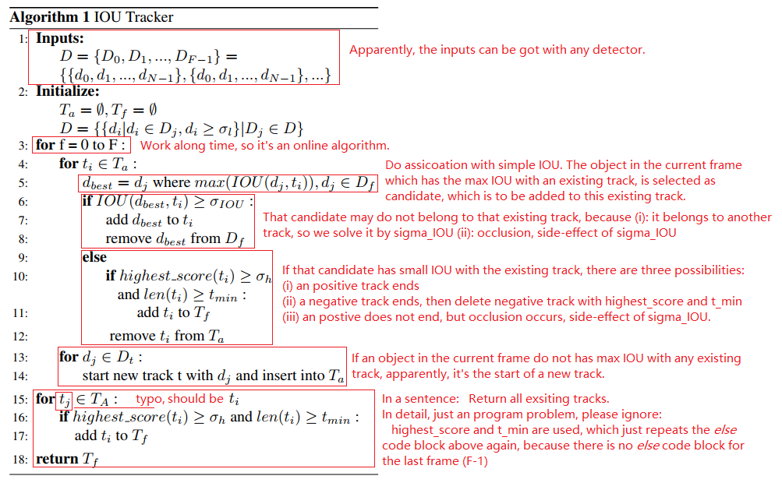

Slide 7
In practice

Slide 8
In practice
Highlight:
1522 fps on MOT17 dataset. Note in MOT17, obejects are 2~3 order of magnitudes.
Code
https://github.com/bochinski/iou-tracker
Result
Result, containing numbers and videos, can be seen at https://motchallenge.net/tracker/IOU17
Comment
Produces a lot of fragments in practice, but should be a nice pre-processing step for other complex algorithm.

